Slide 1

E-RETAIL FACTORS FOR CUSTOMER ACTIVATION AND RETENTION
A case study from Indian e-commerce customers

Slide 2
Problem statement
Customer satisfaction has emerged as one of the most important factors that guarantee the success of online store; it has been posited as a key stimulant of purchase, repurchase intentions and customer loyalty. A comprehensive review of the literature, theories and models have been carried out to propose the models for customer activation and customer retention. Five major factors that contributed to the success of an e-commerce store have been identified as: service quality, system quality, information quality, trust and net benefit. The research furthermore investigated the factors that influence the online customers repeat purchase intention. The combination of both utilitarian value and hedonistic values are needed to affect the repeat purchase intention (loyalty) positively. The data is collected from the Indian online shoppers. Results indicate the e-retail success factors, which are very much critical for customer satisfaction.
apply your analytical skills to give findings and conclusions in detailed data analysis. Only data analysis is required.

Slide 3
Why online shopping?
In physical stores, the sales agents try to influence the buyers to buy the product. While in online shopping, you're free to do as you will.
Saves time and efforts.
The convenience of shopping at home.
Wide variety of products are available.
Good discounts with lower prices.
Get detailed information about the product.
We can compare various brands.
Availability of store is 24 x 7.
And many more

Slide 4
Factors that contributed to the success of an e-commerce store?
Customer satisfaction has emerged as one of the most important factors that guarantee the success of online stores
Customer loyalty
Service quality
System quality
Information quality
Trust
Net benefit
Customer retention

Slide 5
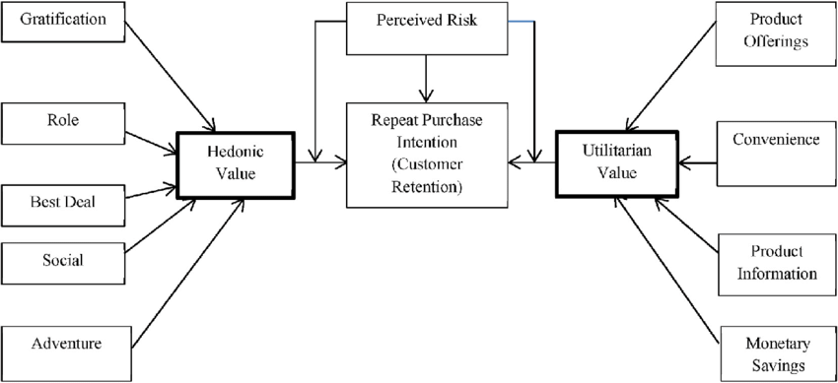
Customer retention or repeat purchase
Customer retention is very important factor in e- commers store which is consists of Hedonic value and Utilitarian values which shows in below block diagram,

Slide 6
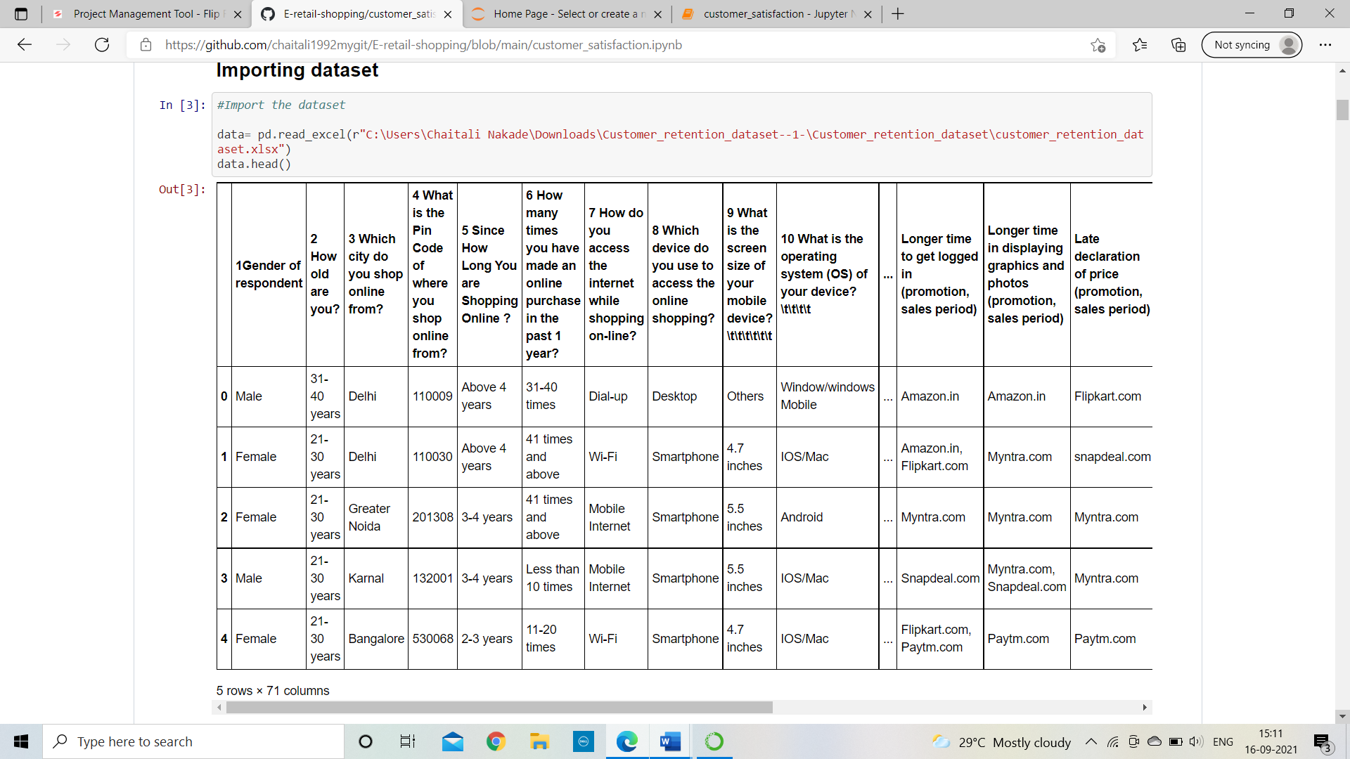
DATA ANALYSIS
Import necessary libraries
Import dataset
After importing the dataset, it will look like this

Slide 7
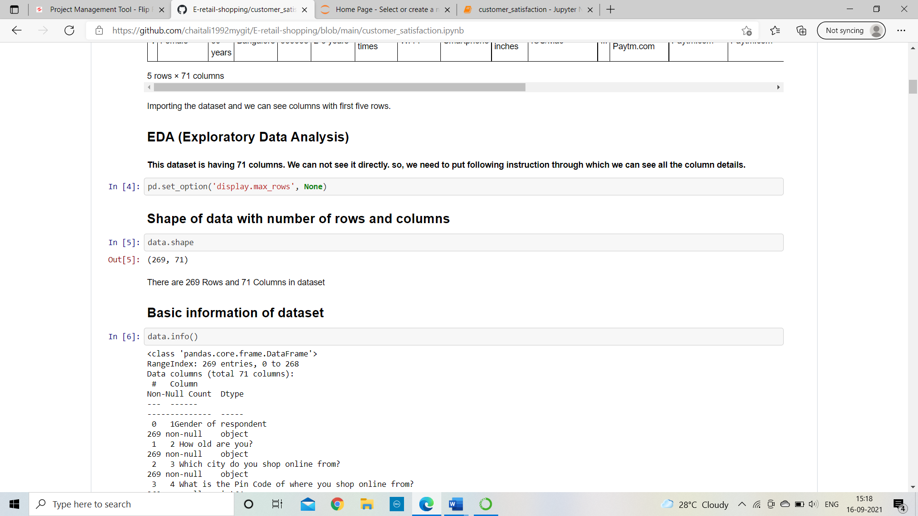
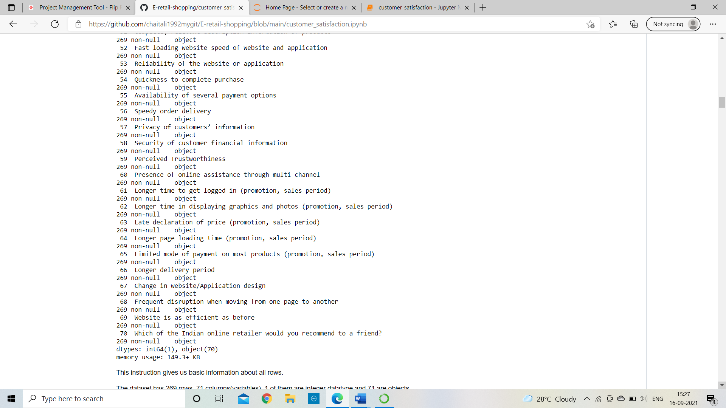
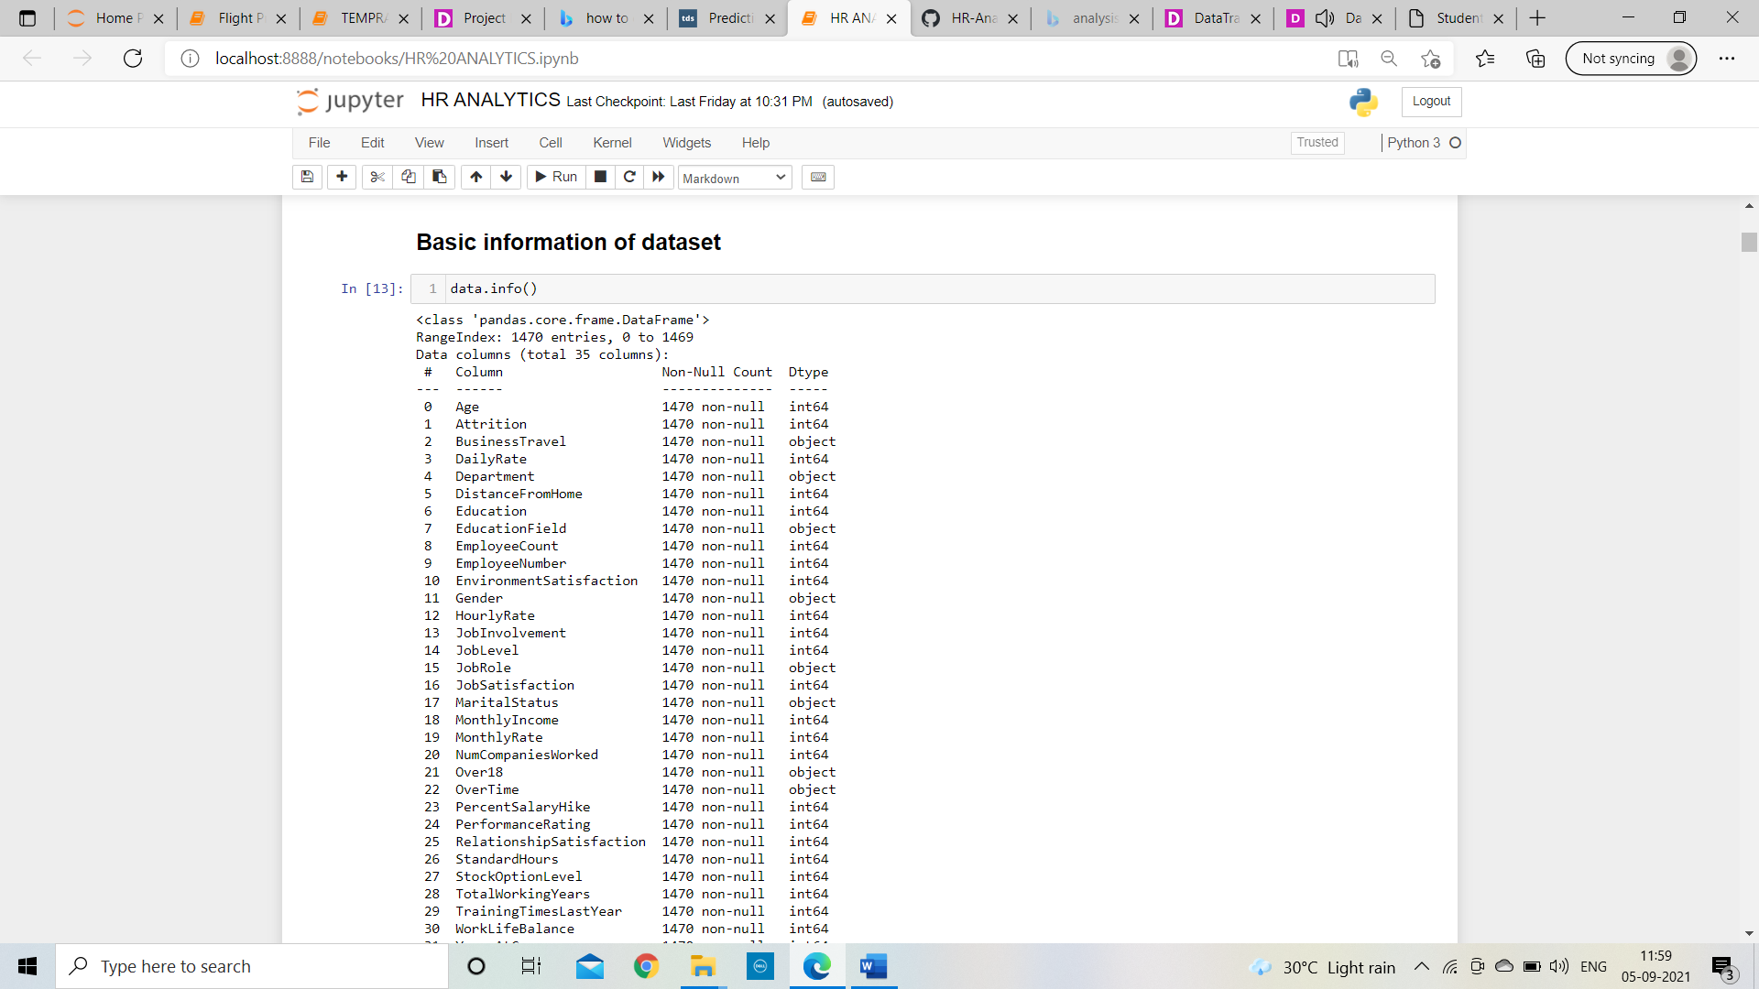
EXPLORATORY DATA ANALYSIS(EDA) Analyse and examine data sets and review their main features, frequently using data visualization methods.
Shape of data with number of columns and rows
There are 269 rows and 71 columns are present in dataset.
Basic information of Dataset:
Only one column is having integer data type and other 70 columns are having object data type and there is no null value values in dataset.

Slide 8
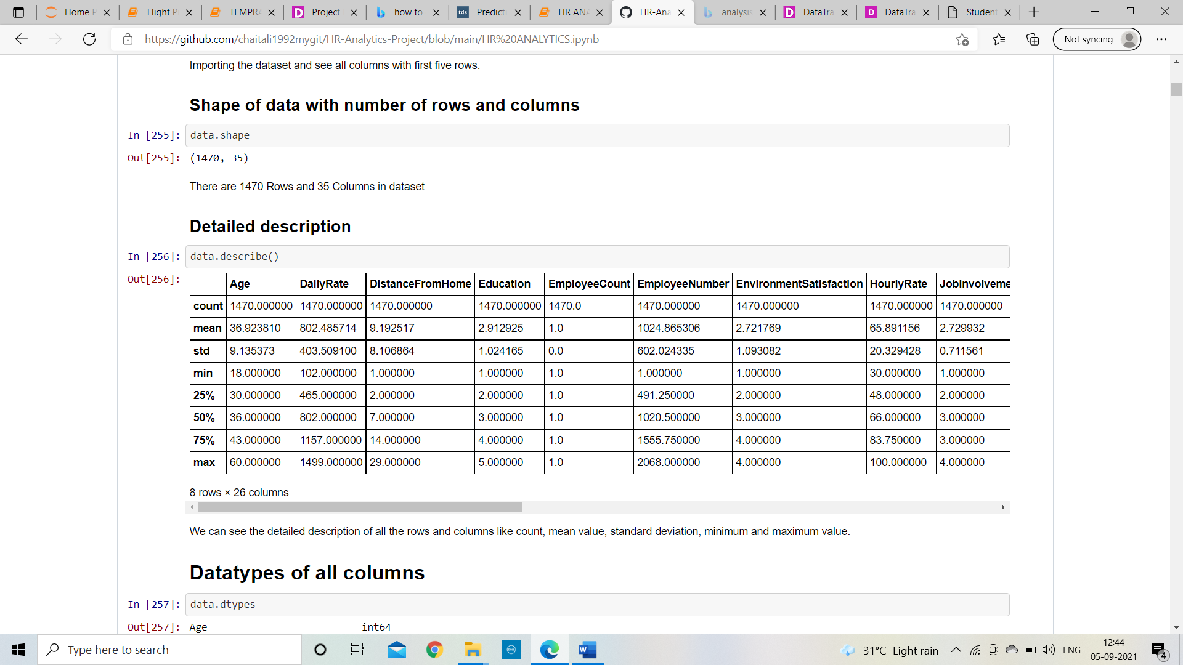
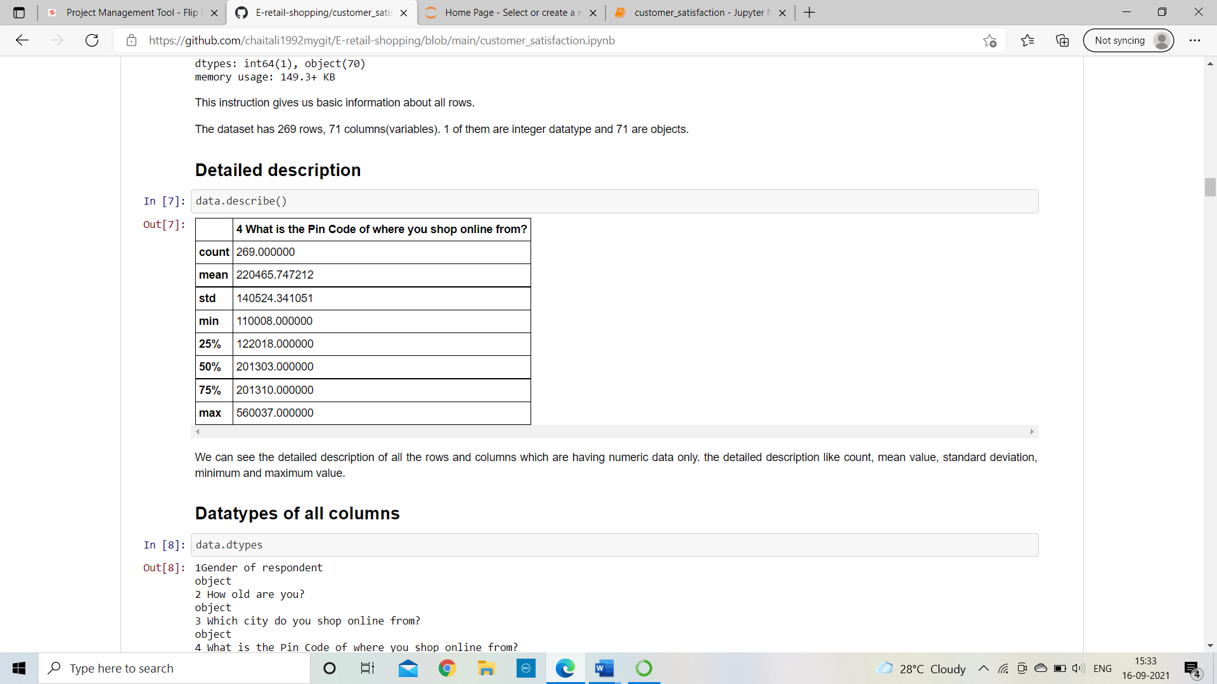
Detailed description of dataset
Description of dataset
This will work only on numeric datatypes in which average value is : 220465.74
Standard deviation : 140524.341051, minimum value: 122018.0, 1st quantile, 2nd quantile, 3rd quantile and maximum value: 560037.00

Slide 9
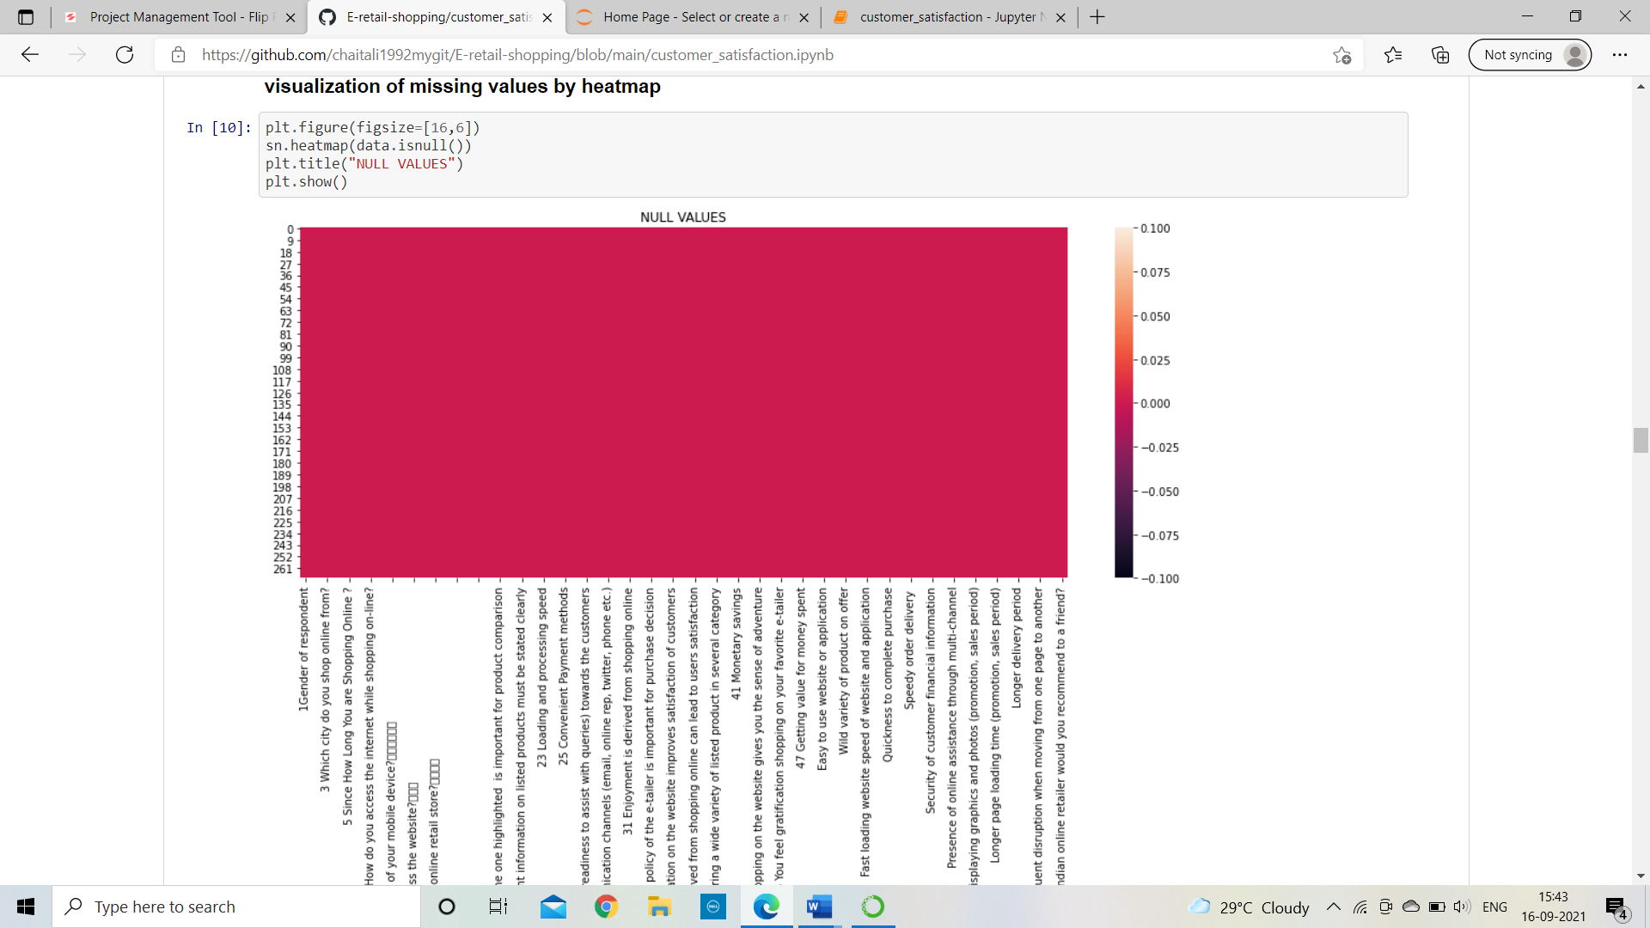
Data Visualization of null values
Check is their any null value present in dataset
After analysing the above fig. there is no white lines present in whole figure. So, it means there is no null value in whole dataset.

Slide 10
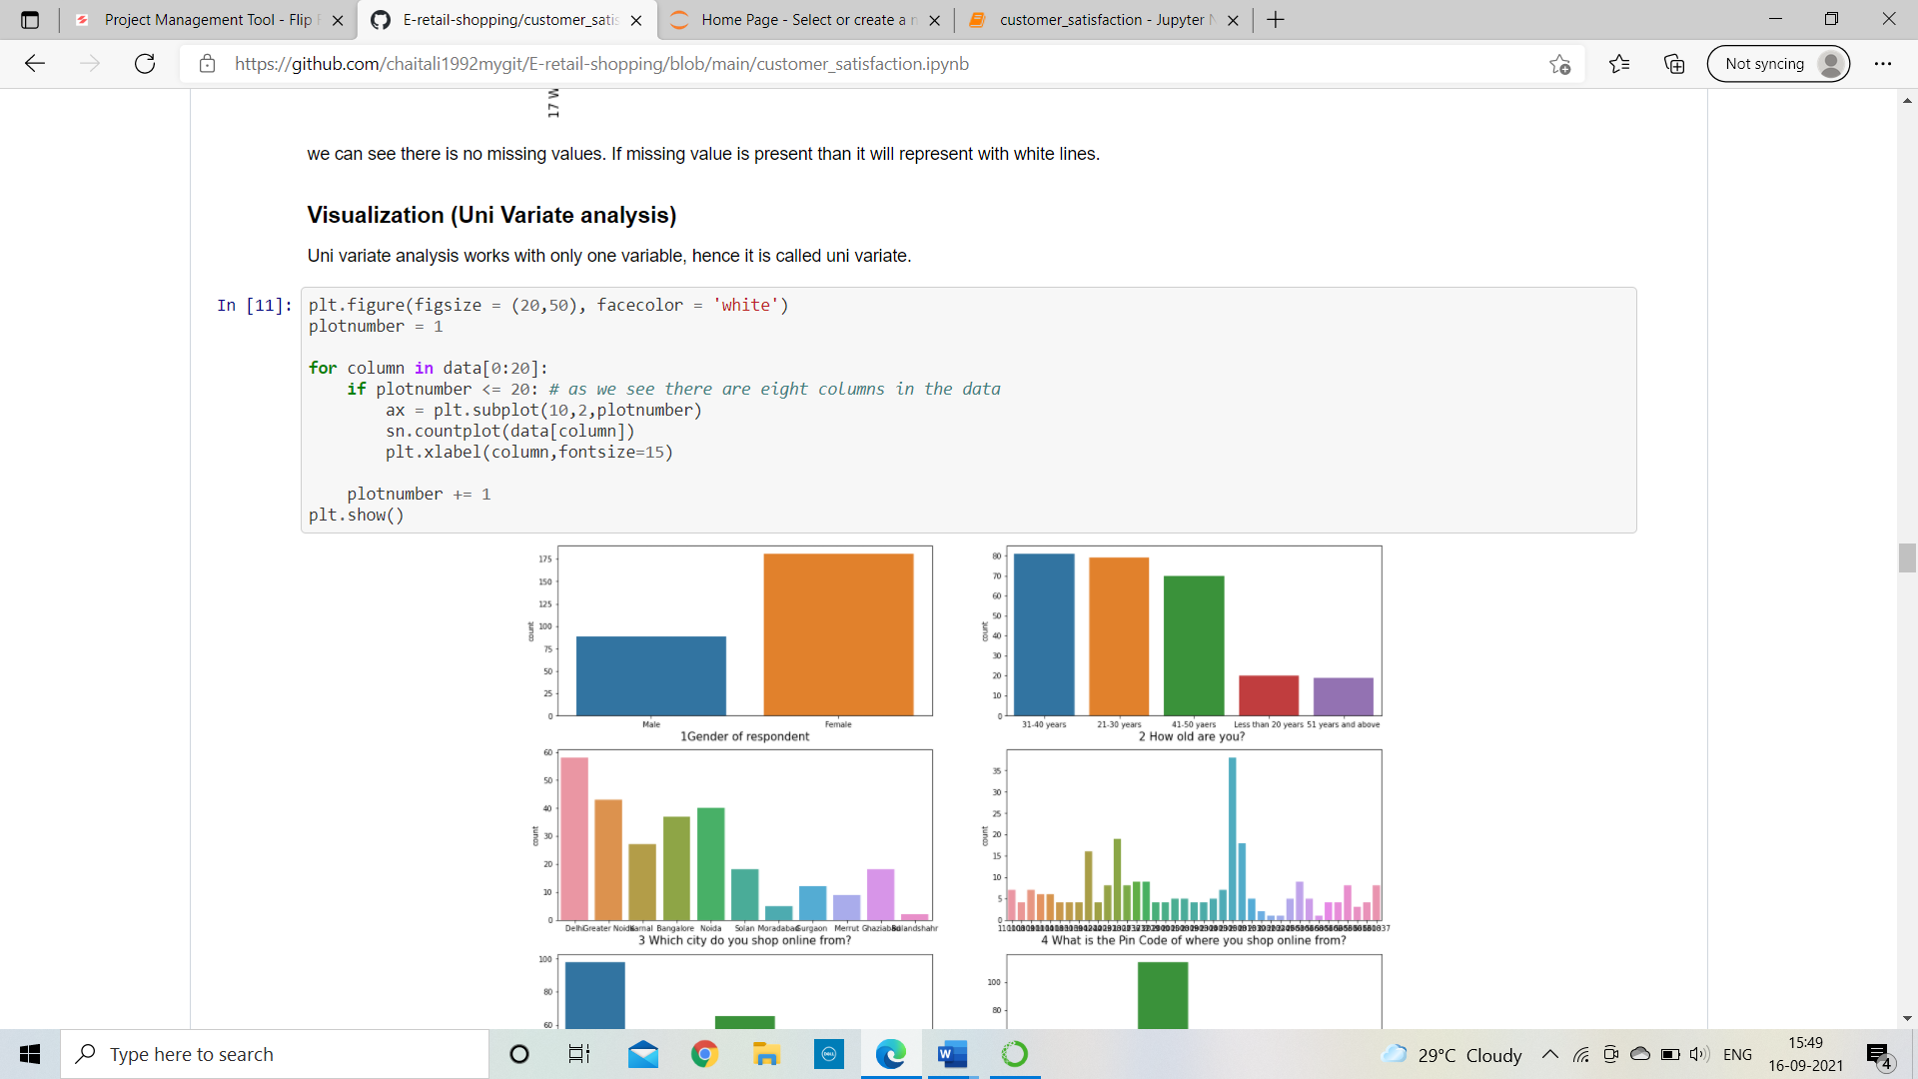
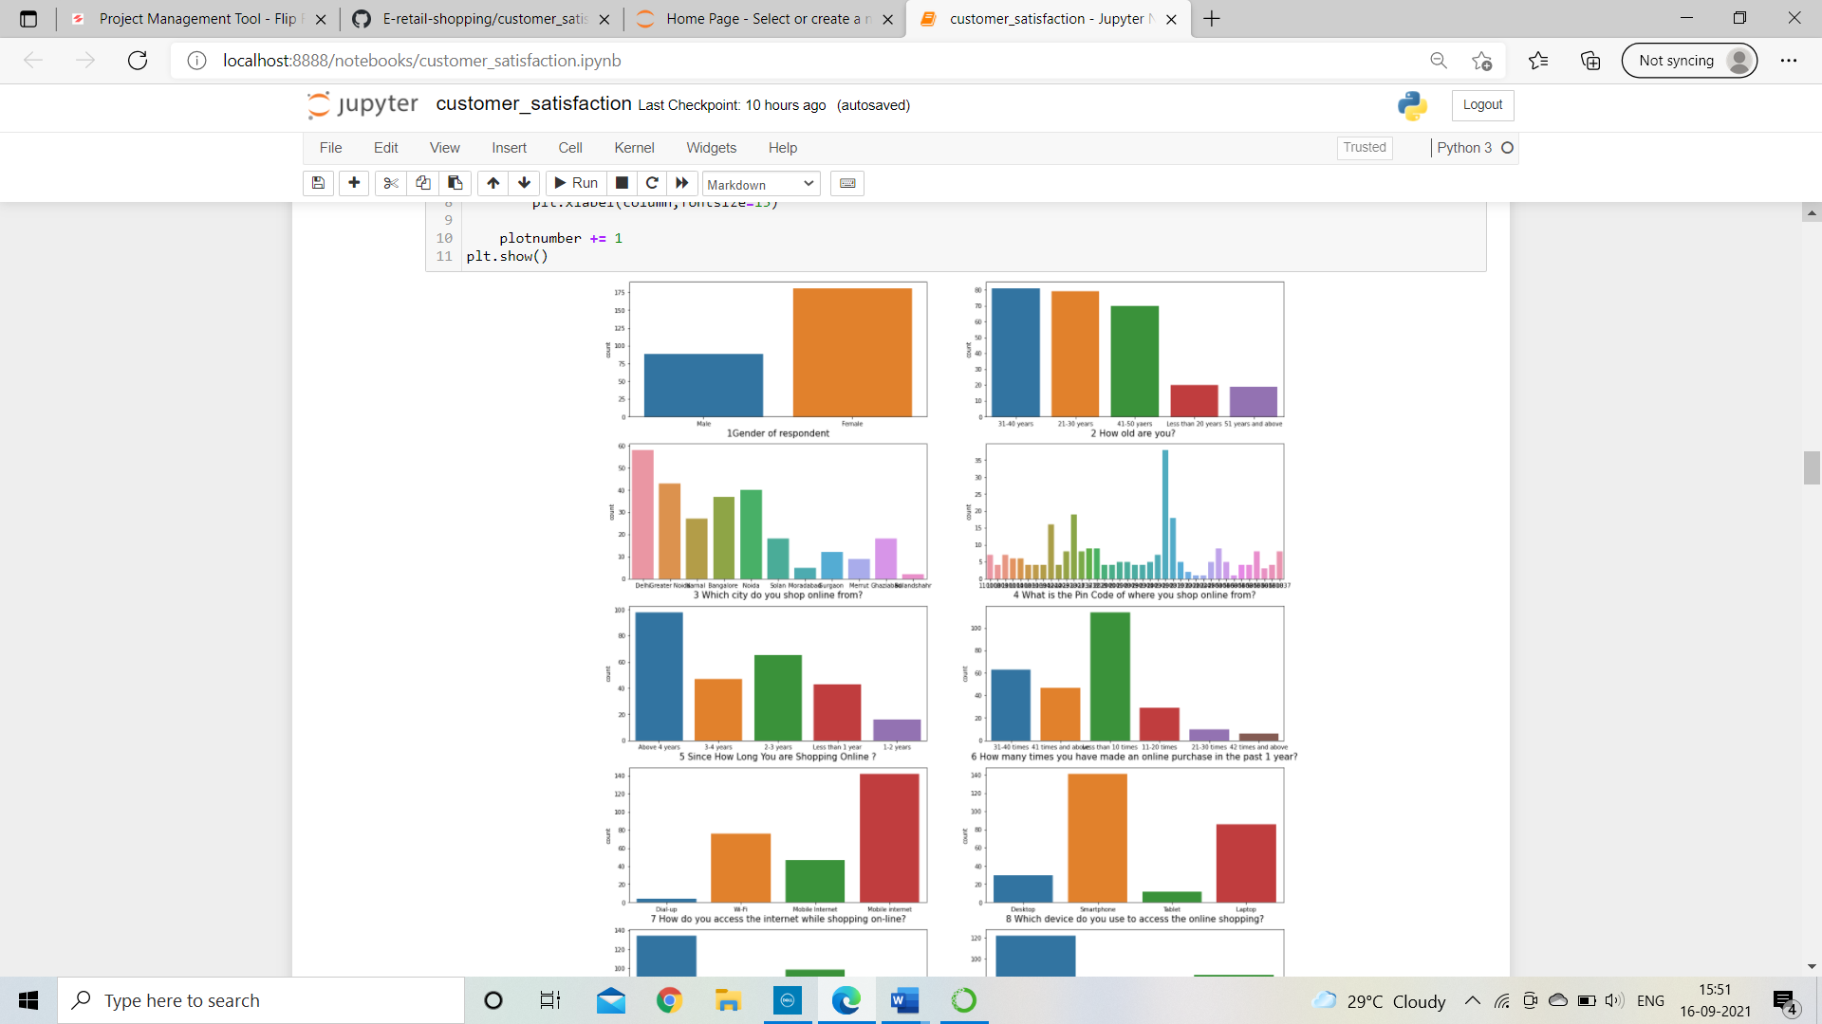
Visualization through count plot
First, I will plot only 20 columns out of 71. So, I can analyse it properly

Slide 11
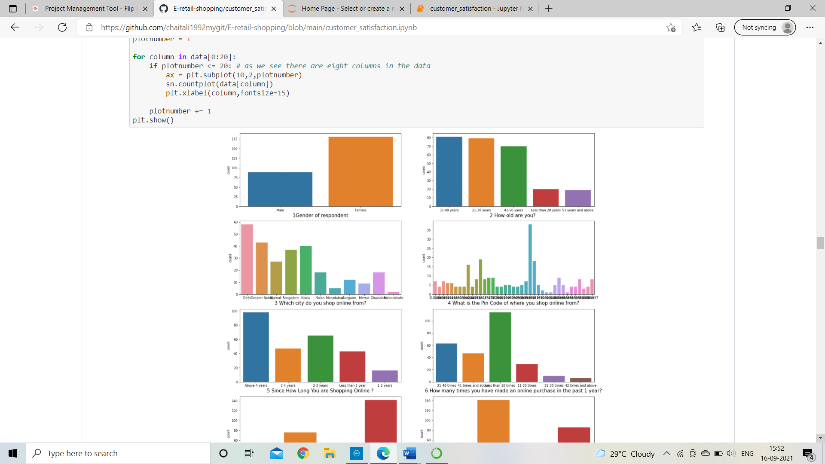
Uni variate analysis
It counts the classes and returns a quantity of their occurrences.
Gender of respondent →
Females are more likely do the
shopping as compare to males
How old are you? →
whose age are lies in between
21 to 4o years are usually do
the more shopping.

Slide 12
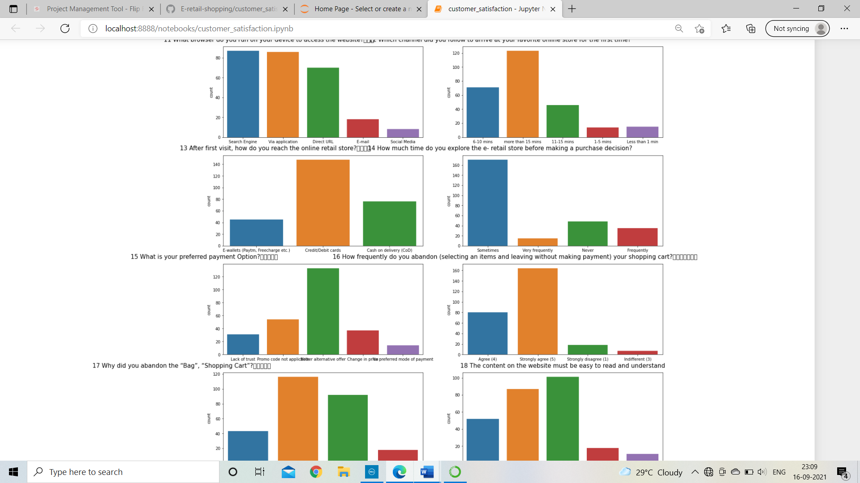
Preferred payment option →
Maximum customers are happy to do
payments through credit or debit cards
Which city do you shop online from? -->
Delhi people are more likely to do more
shopping as compare to other cities people.

Slide 13
Since how long you are shopping online?
→ More customers are doing shopping since
last 4 years with peak of 95
How do you access the internet while
shopping on-line? →
Mobile internet is priority of customers
while doing online shopping
Which device do you use to access
the online shopping? →
Maximum people are likely to do shopping
through smartphones and tablet is in
least priority to do shopping.

Slide 14
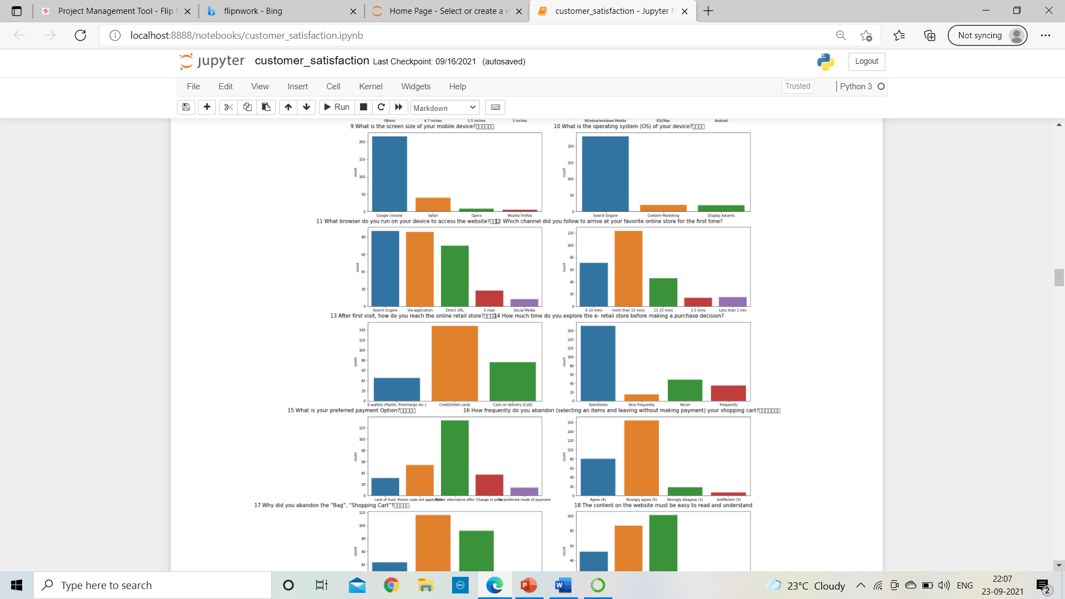
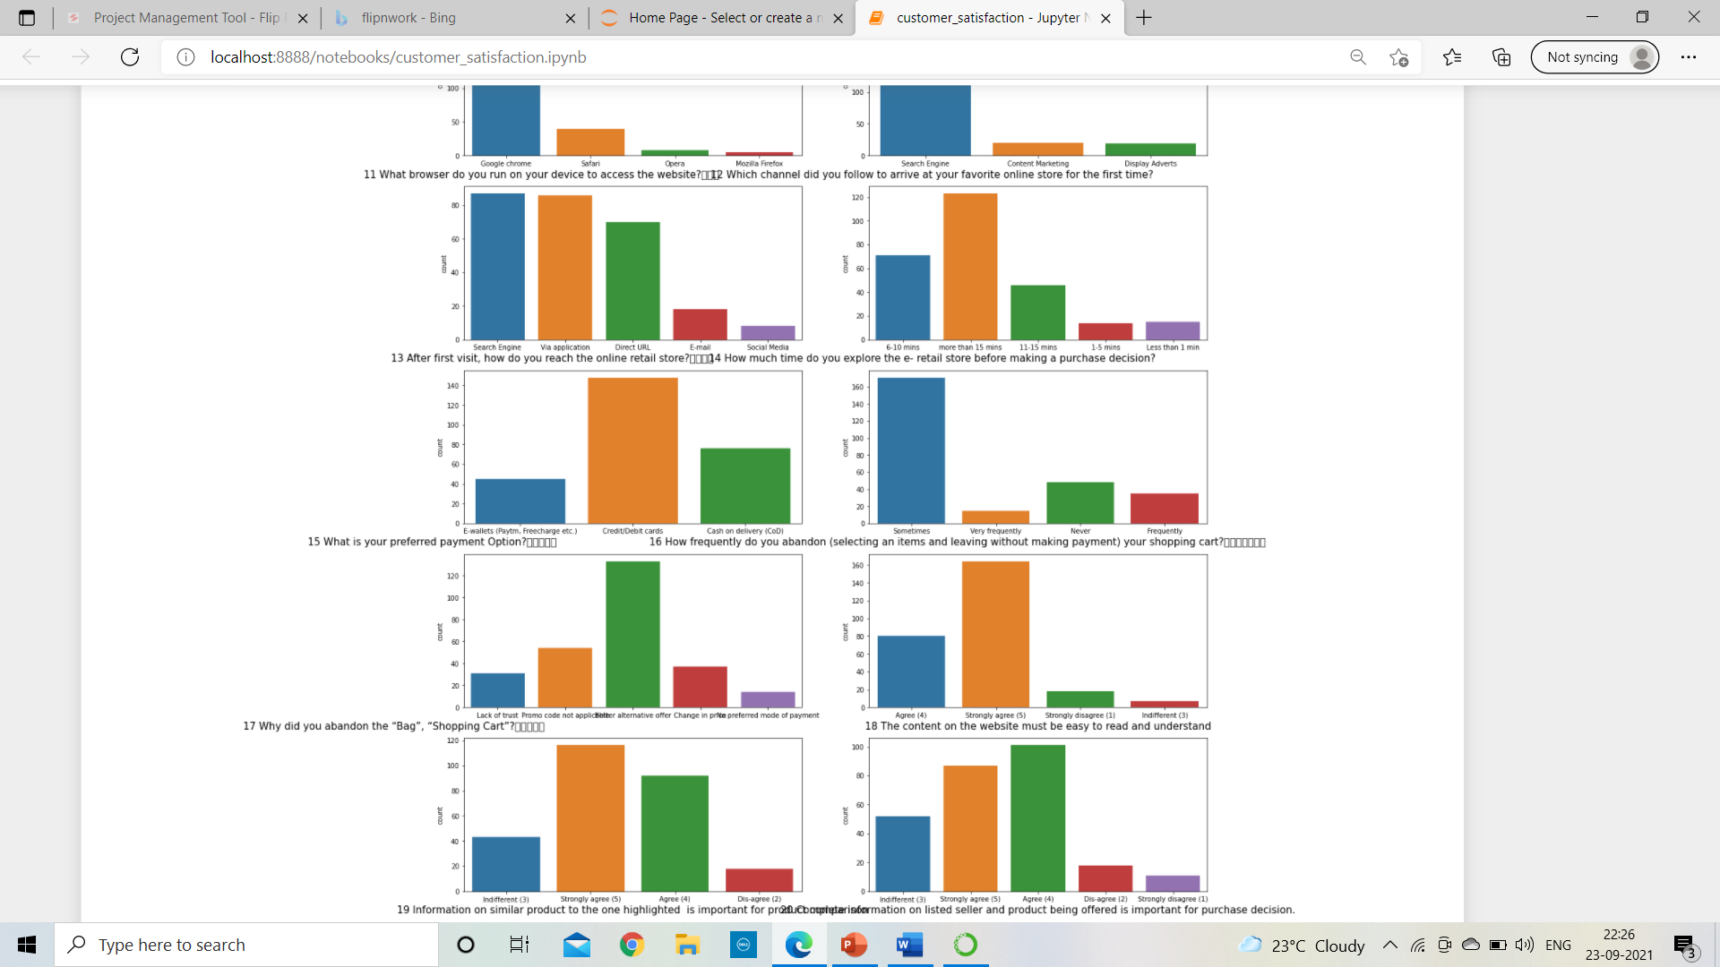
What browser do you run on your
device to access the website? →
Google chrome are more likely to
used by customer for online shopping
Majority of customers are
agree/ strongly agreed
for website content and
highlight of similar products.

Slide 15
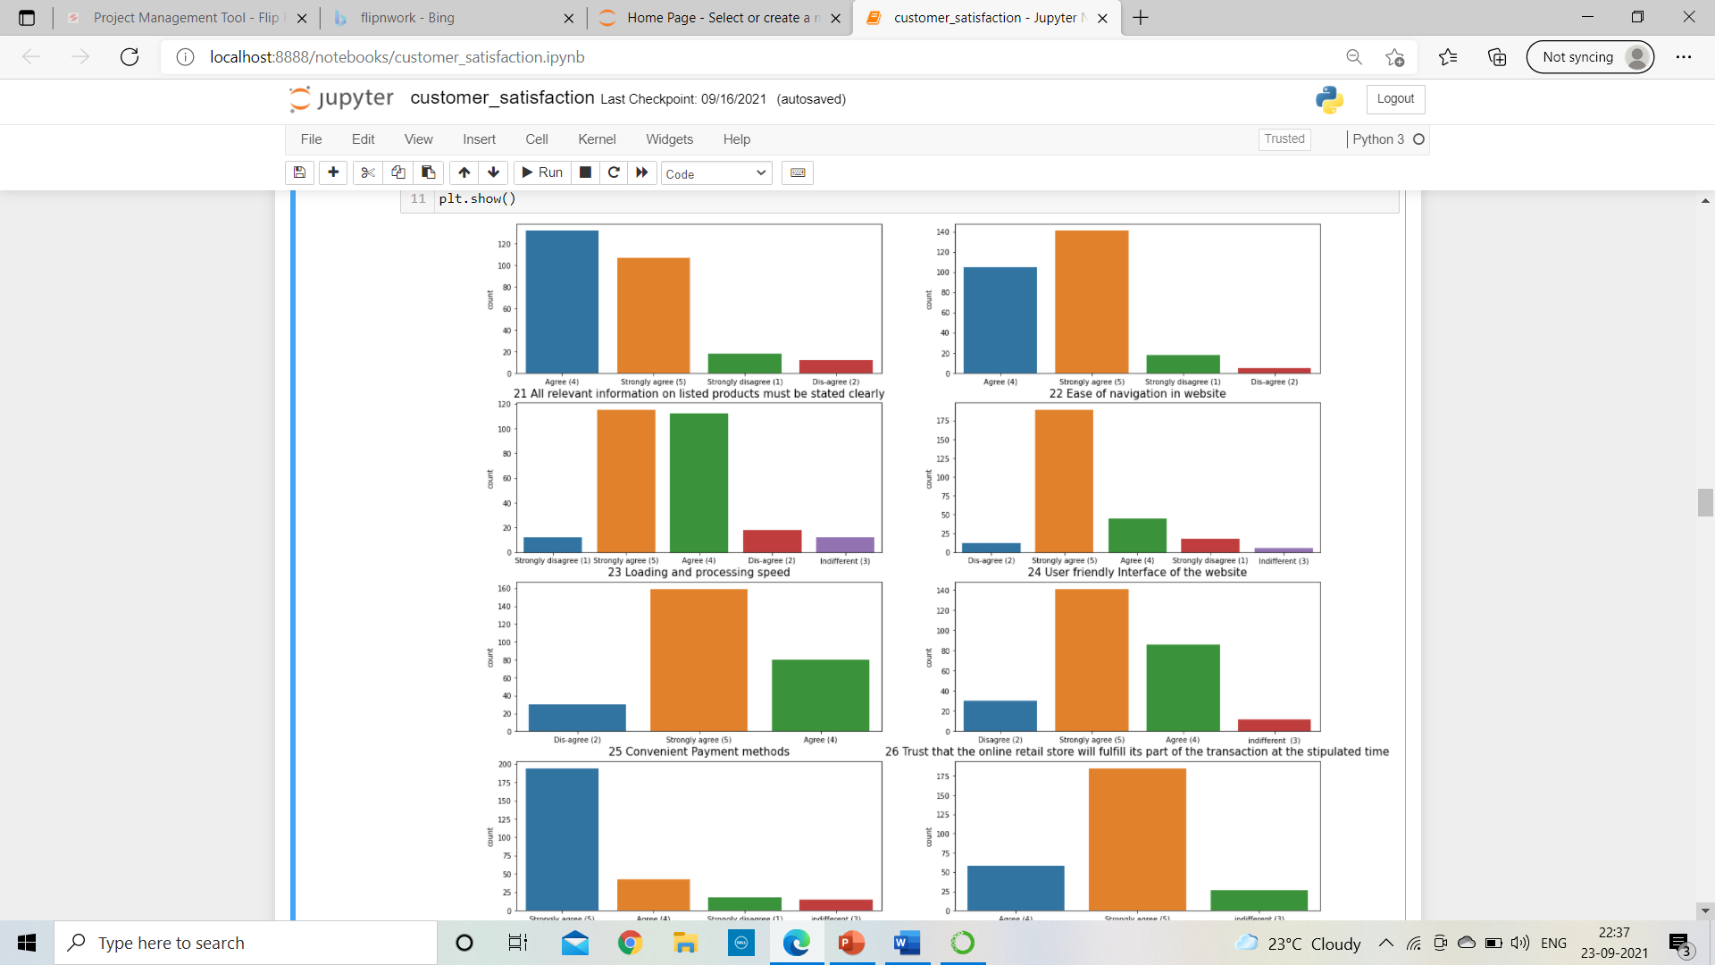
Very less customers are disagreeing with the valuable content regarding effective online shopping and rest are either strongly agree or agree for that.

Slide 16
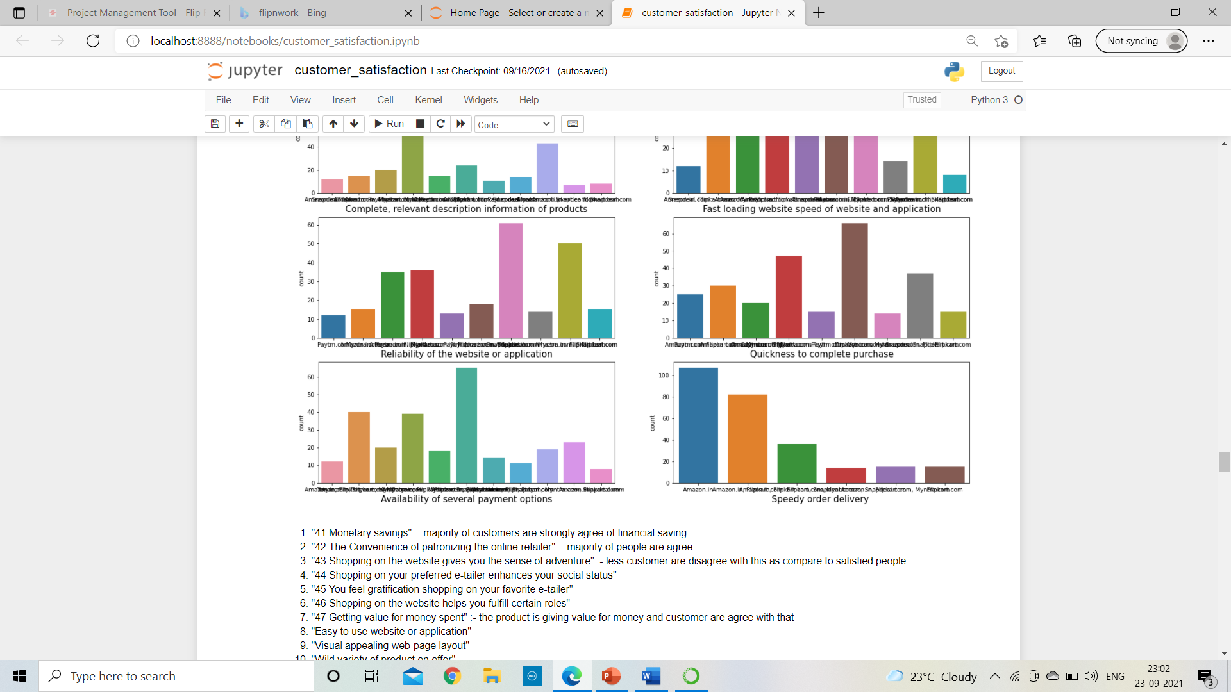
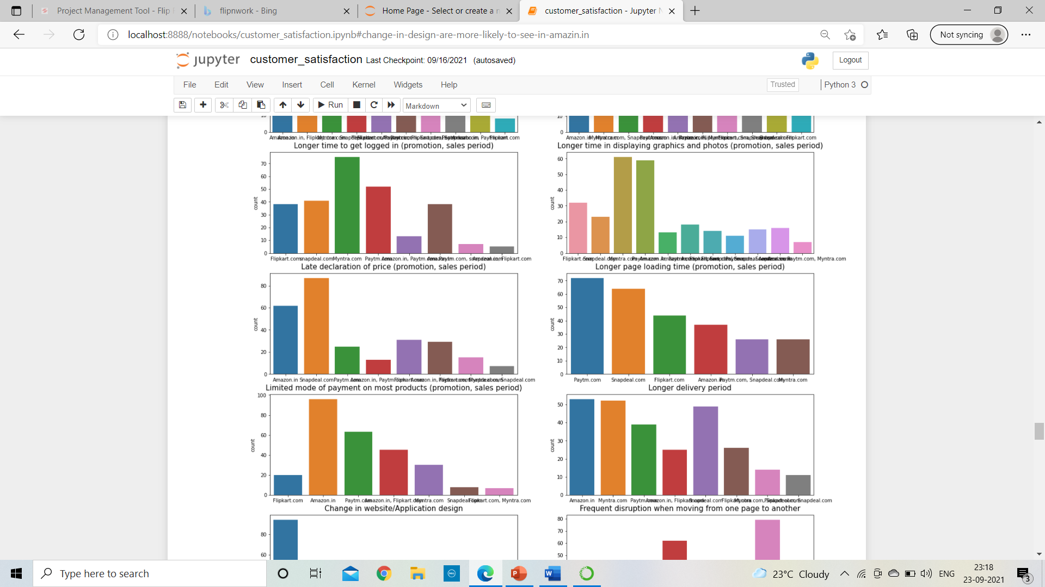
Speedy order delivery →
diagram amazon.in is proving
fastest delivery compare to other

Slide 17
Amazon.in is having more privacy as compare to other web sites
Amazon.in is having very secure financial services as compare to other websites
Amazon.in is taking too much to time to log in as compare to other websites
Myntra.com is declare very late price compare to other
majority of customers are facing loading of pages in websites and that websites are myntra and amazon with peak of myntra.com
Limited mode of payment on most products are having in snapdeal.com
We can see paytm.com and snapdeal.com taking longer delivery period with peak of paytm.com
change in design are more likely to see in amazin.in

Slide 18
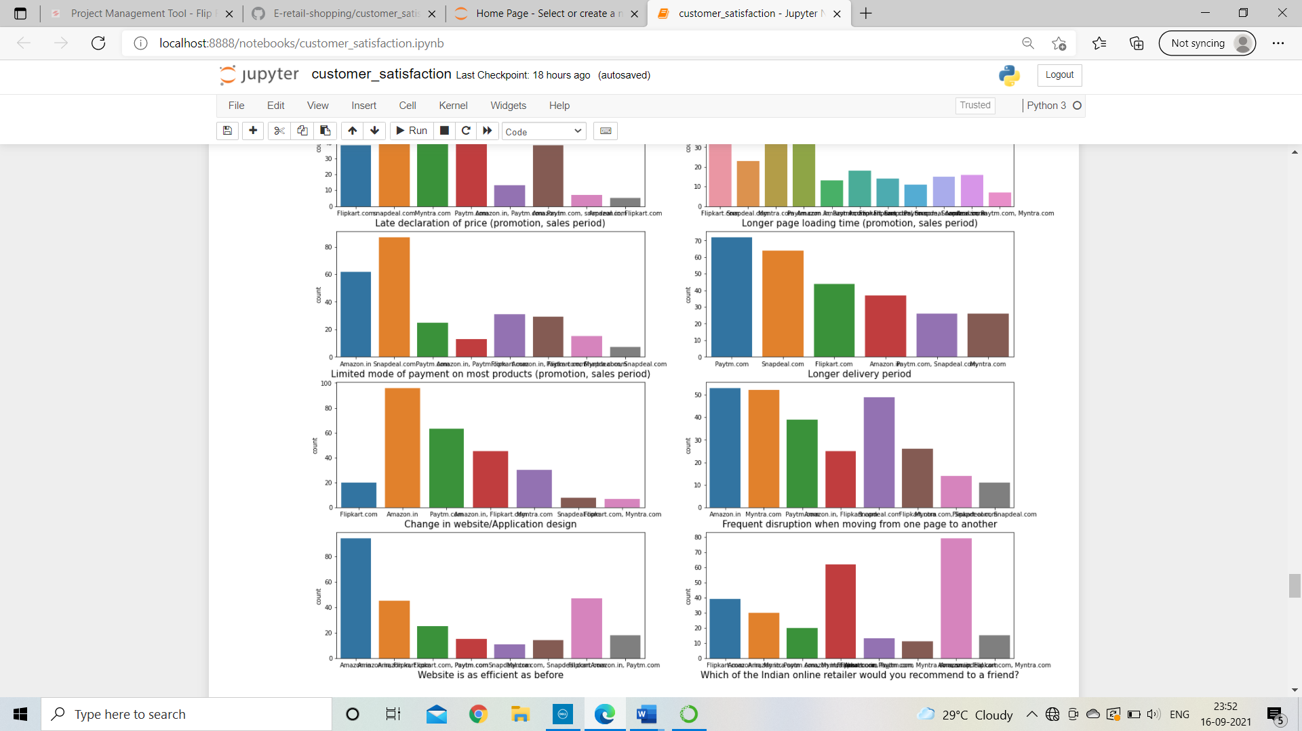
Conclusion
Which of the Indian online retailer would you recommend to a friend?
As we can see majority of customer are likely to prefer and suggest amazon.in and myntra.com with peak of amazon.in.

Slide 19
Conclusion
After analyzing the data we can found that the important factor which affects the online shopping. Customer satisfaction one of the most important factor in any platform and e-retail shoppers gives priority to it. We can see people more attracted towards the online shopping because of all this significant factors. The market of online shopping will automatically increase if we improve the Quality of services.

Slide 20
Thank you

